Slide 1
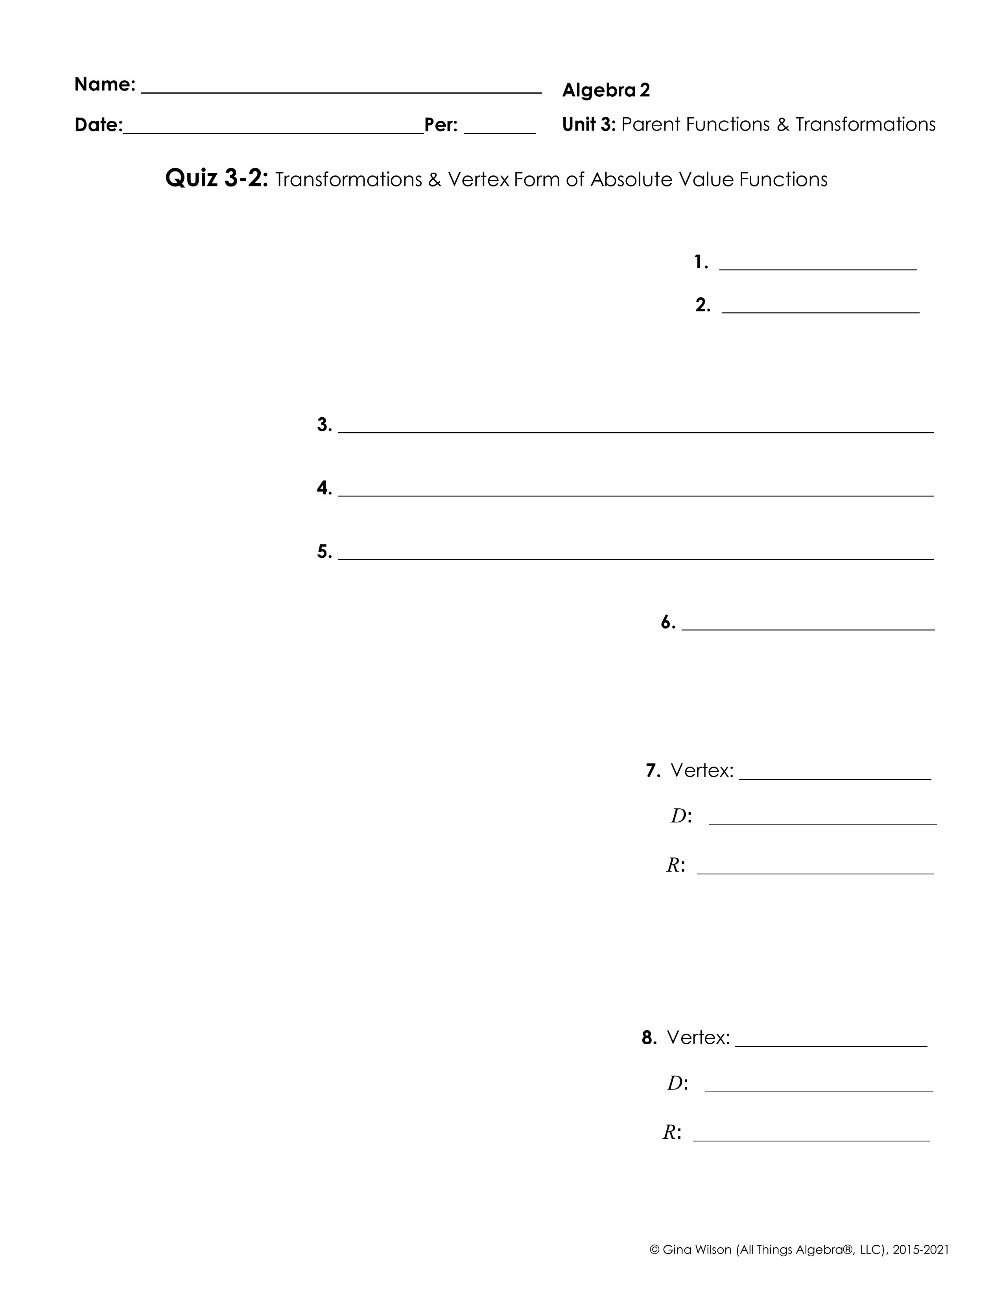
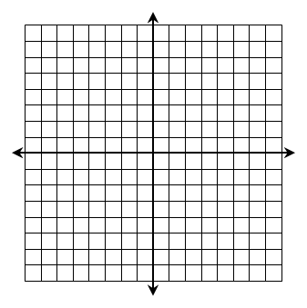
Identify the parent function of each function family. \
1. Linear
2. Absolute Value
Describe the transformations that were applied to the parent function.
3.
4.
5.
6. Dale graphed the absolute value parent function. Then, he reflected the graph over the x-axis, shifted it four units to the right and three units up. Give the new equation.
Identify the vertex, then graph. State the domain and range.
7.
8.

Slide 2
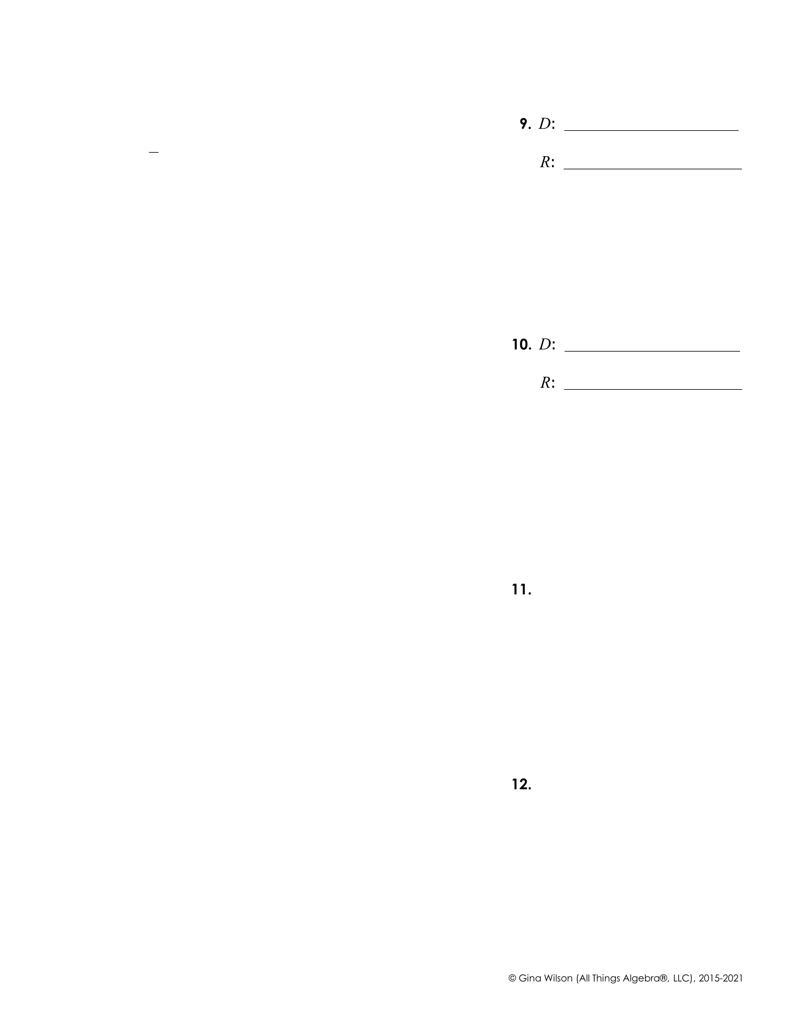
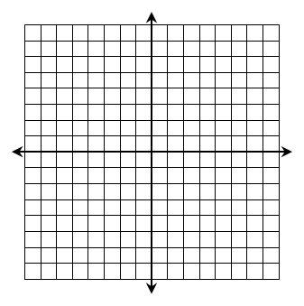
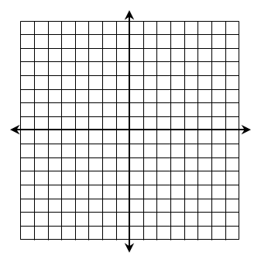
9.
10.
Graph each inequality.
11.
12.

